Slide 1
Community Board 6
By Ibrahima Barry

Slide 2
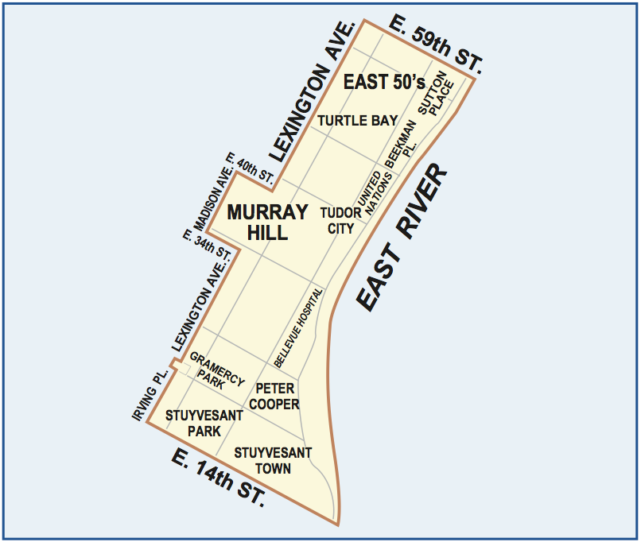
CB6

Slide 3
Assumption
Winter: Trash, Noise
Spring: Heat, trash, Hot water,
Summer: Noise, broken Muni Meter
Fall: Noise, Heat

Slide 4
Top 10 and graphs

Slide 5
Next

Slide 6
Next

Slide 7
Next

Slide 8
Changing assumption
Yes, each season here is always a
noise complain
Taxi
Broken Muni meter
Illegal parking
Water system
General construction/Plumbing
Homeless person Assistance

Slide 9
Diving into winter 2014 & 2013 data
the differences between the two seasons
- 2013 _ Plumbing_
-2014_ Fire Safety Director - F58­_ Vending
In 2015 maybe both

Slide 10
Heat and Hot water
Based on my data people complain the mush during December, January, February and March.
Based on the season.
https://barryi.cartodb.com/tables/table_26/map

Slide 11
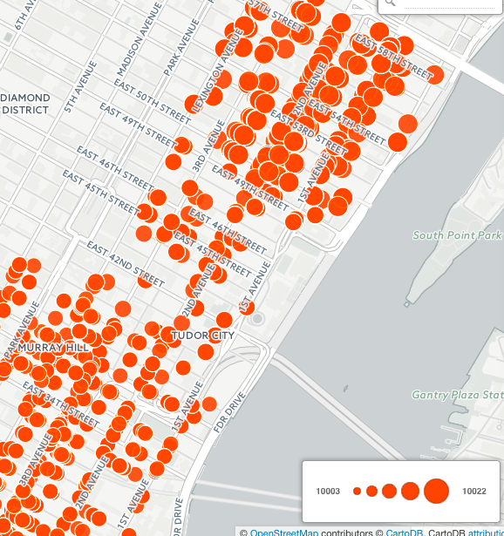
Complaint Types

Slide 12
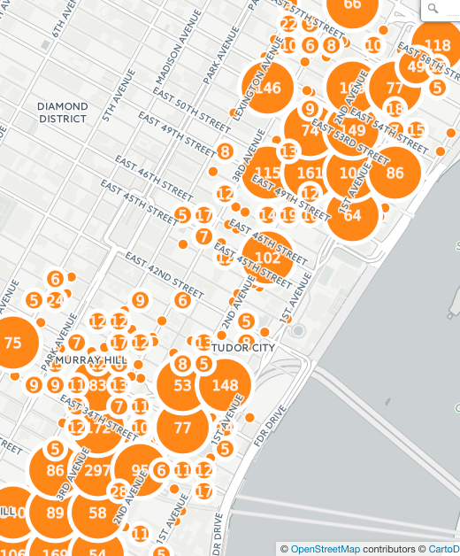
Descriptor

Slide 13
Rodent Service Requests
https://barryi.cartodb.com/tables/table_24/map

Slide 14
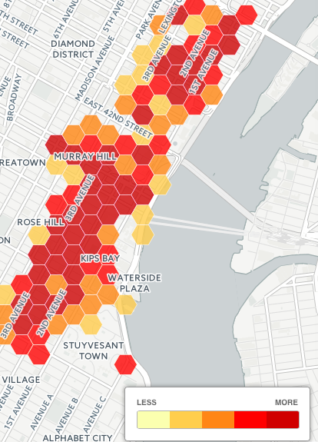
Heat map

Slide 15
Street Condition
Loud Music/Party
Loud talking
Pothole
Defective Hardware
Plate Condition _Noise

Slide 16
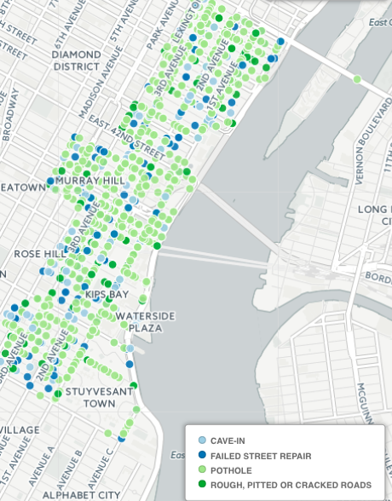
map

Slide 17
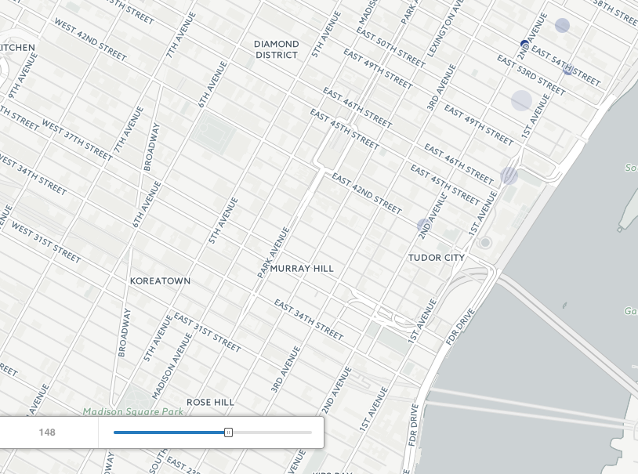
60 days real Time

Slide 18
Noise
Construction Before/After Hours (NH1)
Construction Before/After Hours (NH1)
Jack Hammering (NC2)
Loud Music/Party
Loud Talking
Barking Dog
Engine Idling
Air condition/ventilation equipment
Car/Truck Horn
Banging/Pounding

Slide 19
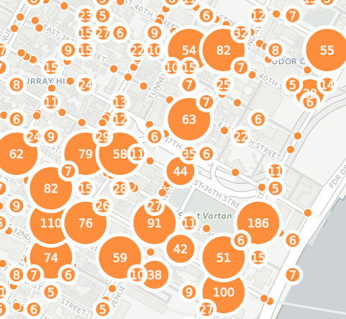
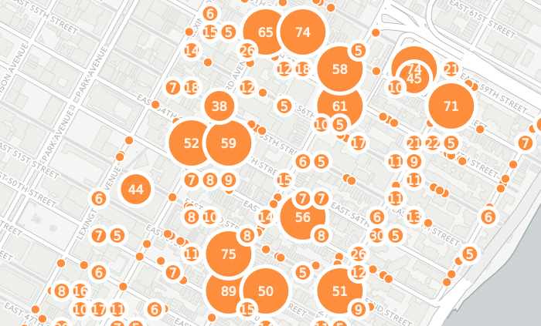
Map: https://barryi.cartodb.com/viz/5131074e-8d54-11e5-8ad5-0e8c56e2ffdb/map

Slide 20
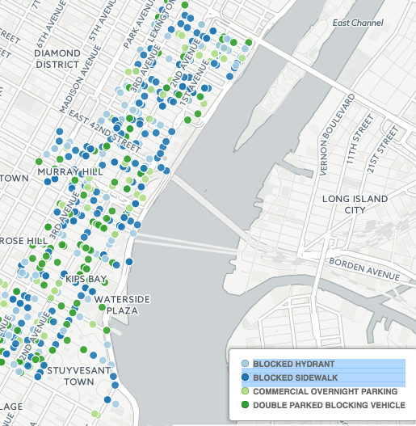
Illegal parking

Slide 21
next
https://barryi.cartodb.com/tables/illegal_parking/map

Slide 22
Conclusion
Based on my understanding CB^6 has a lotto work on because each its increasing.

